Slide 1
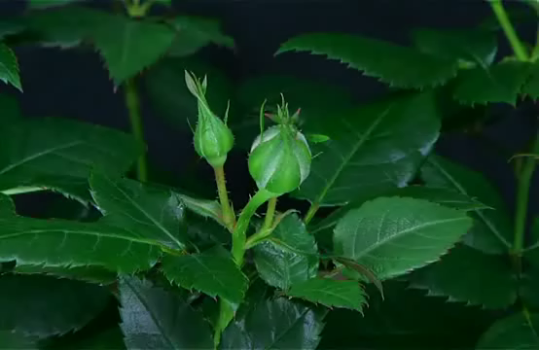
  WELCOME

Slide 2
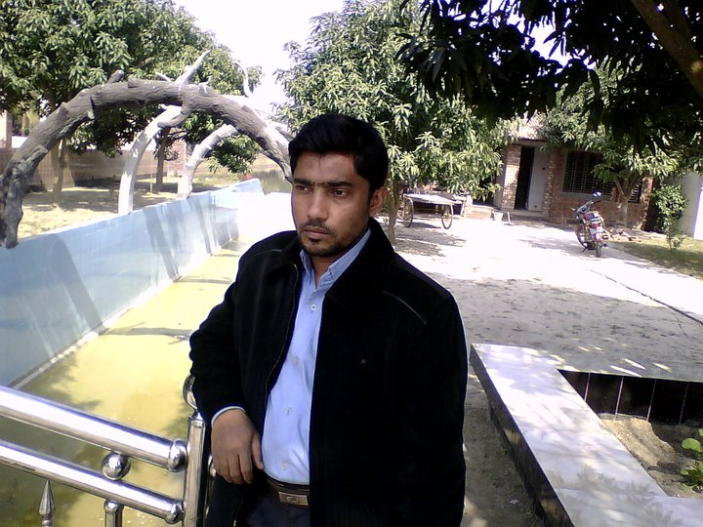
Teacher introducing
Identity of teacher:
Md. Nur Kutubul Alam
Assistant Teacher[Computer]
Shaplakali Adarsha Secondary School, Jibannagar, Chuadanga
Mobile: 01913207130
E-mail arenacomputer1@gmail.com
arena01.blogspot.com

Slide 3
Class Eight
English Second Paper

Slide 4

She are reading a book.

Slide 5
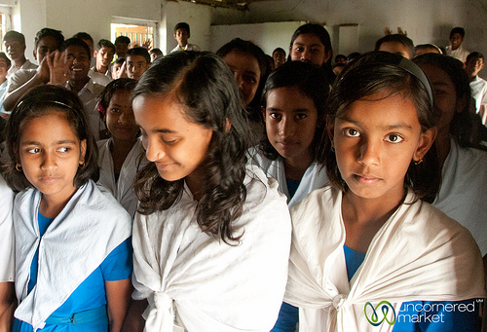
We is students.

Slide 6
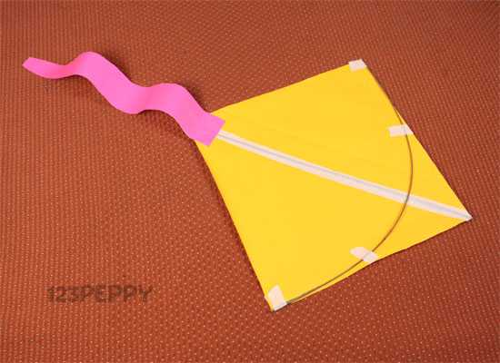
They has made a kite.

Slide 7
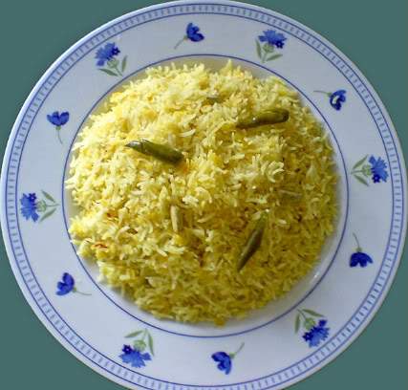
I eats rice.

Slide 8
Can you guess what are we going to learn today?

Slide 9
Right Form of Verbs

Slide 10
Objectives
By the end of the lesson students will have--
made right use of verbs in sentences.
made right use of verbs in the bracket.
known where is singular & plural verb used.
made sentence using present tense.

Slide 11
1.Man[be] mortal.
2.The moon[shine] at night.
3.God [love] all.
Which tense has been used and why?[discuss in pair and answer]

Slide 12
Answer;
1.Man is mortal.
2.The moon shines at night.
3.God loves all.
* present indefinite tense has been used to show universal truth.

Slide 13
1.He always [come] late.
2.I[ take]tea regularly.
3.She generally[go] by rickshaw.
Which tense has been used and why?[discuss in pair and answer]

Slide 14
Answer
1.He always comes late.
2.I take tea regularly.
3.She generally goes by rickshaw.
4. My mother reads Quran daily.
*Present indefinite tense is used in the sentences having always, regularly, often generally, daily, usually, normally etc.

Slide 15
3 m
1.She just [return] home.
2. I already[finish] the work.
3.They[buy] a car recently.
Which tense has been used and why?[discuss in pair and answer]

Slide 16
Answer;
1.She has just returned home.
2. I have already finished the work.
3.They have bought a car recently.
Present perfect tense is used in the sentences having just, just now , already, recently etc.

Slide 17

1.She has [help] the old man.

Slide 18
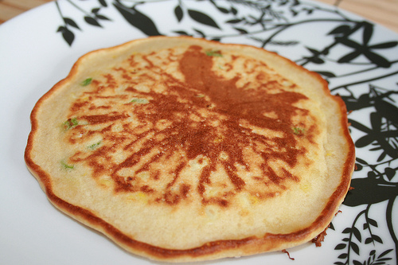
We have [prepare] rice-cake.

Slide 19
1. She has helped the old man.
2. We have prepared rice-cake.
Which form of verb is used after have/has/had?[think individually and answer]

Slide 20
Past participle form of verb is used after have/has/had.

Slide 21
Practice---[In pair]
1.Ice[ float] on water.
2.Mira[prepare] her lesson now.
3.She already[send] the news.
4.He has[catch] a bird.

Slide 22
1.He behaves as if/as though he [know]everything.
2.He behaved as if/as though he [know]everything.
Comment on the tenses of 2 parts of above sentences.[in group]

Slide 23
answer
1.He behaves as if/as though he knew everything.
2.He behaved as if/as though he had known everything.
*If 1st clause is present indefinite tense ,2nd clause is past indefinite but if 1st clause is past indefinite,2nd clause is past perfect tense.

Slide 24
1. She [try] for 2 hours.
2. You [read] since morning.
3. It[rain] for a week.
Answer;
1. She has been trying for 2 hours.
2. You have been reading since morning.
3. It has been raining for a week.
*When fixed time is mentioned in continuous sense, it becomes present perfect continuous tense.

Slide 25
Home task
Fill in the gaps using right form of verbs. Put them in the correct tense.
sale | know | swim | run | finish
She talks as if she---- everything.
I have just-----my breakfast.
I saw him----.
Rice is----30 taka a kg.
They----for 2 hours.

Slide 26

SEE YOU AGAIN

